Slide 1
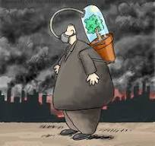



What `s the problems

Slide 2



Our Solution.

Slide 3

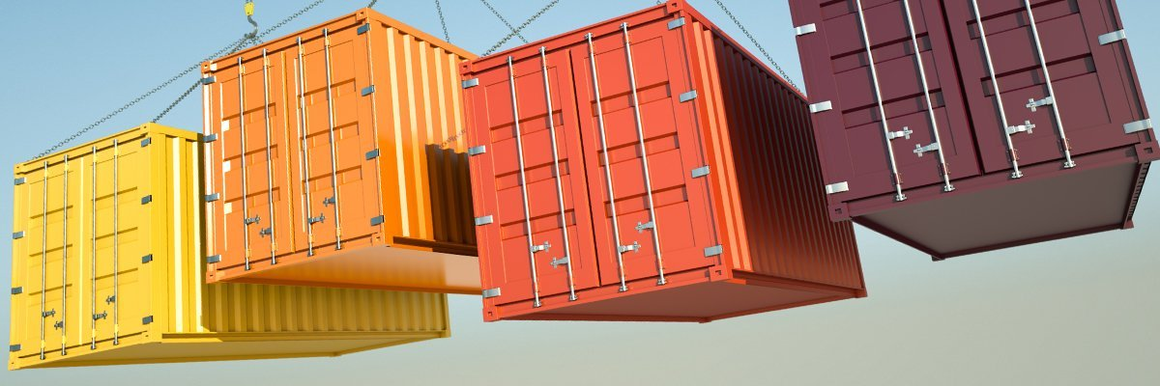
Our platform Is full modular And OpenSoures

Slide 4
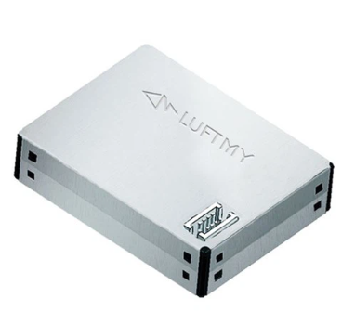
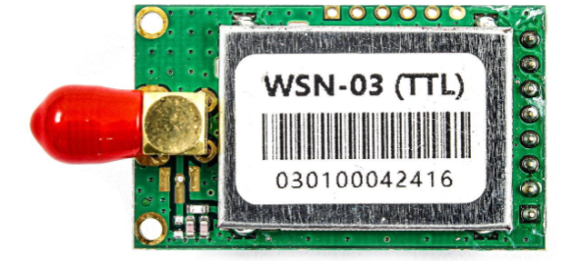
Sensor box
LD11TVC
WSN-03 RS232 RS485

Slide 5
Diagram of Our Platform Work

Slide 6
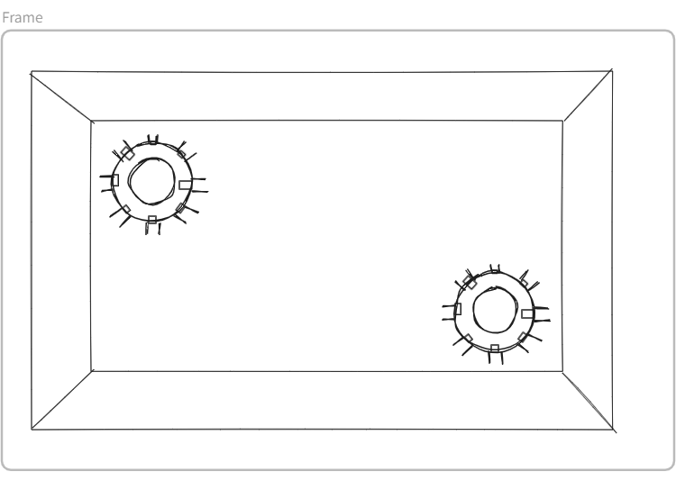
Sensor Box

Slide 7
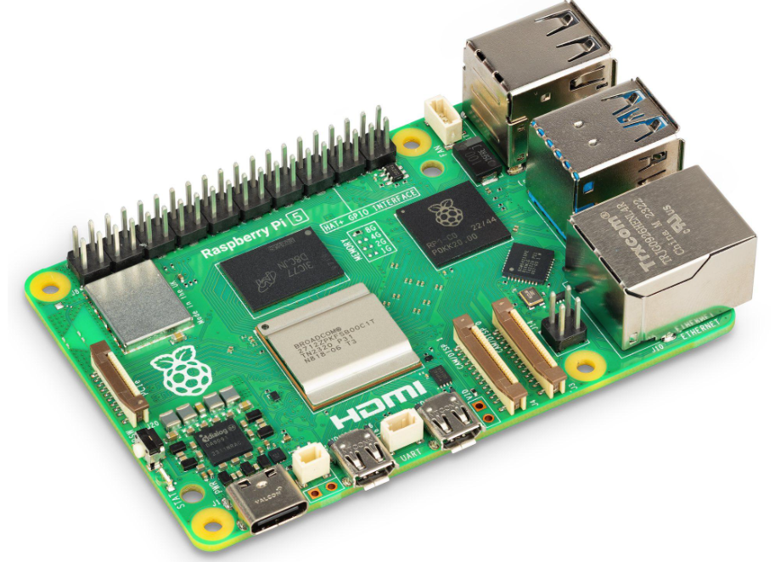
Local server
Local Server gathering data From every sensor Box in the city and Area, then send data to the server for optimize and process .

Slide 8
information
The box gathering data of sensor .
Sensor Box first save information on sd-card .
And Then send With API to the server

Slide 9
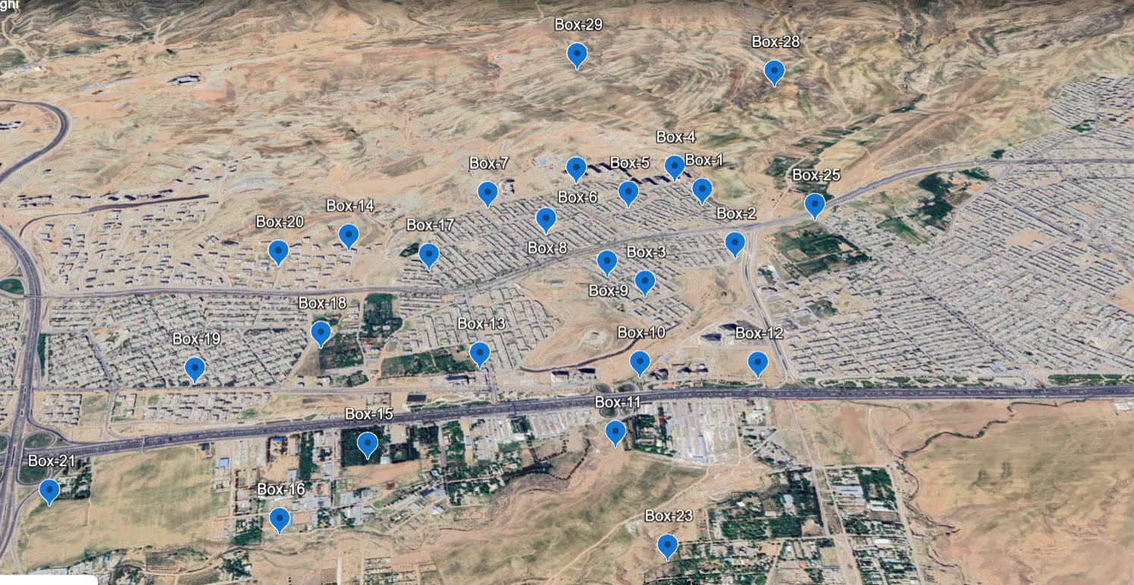

Slide 10
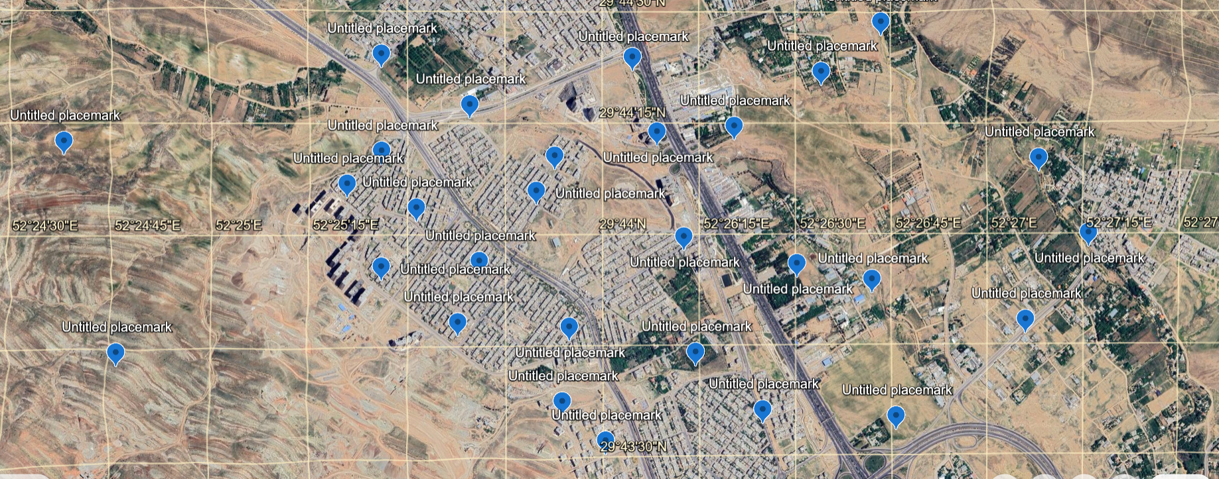
The map of sensor on the city .

Slide 11
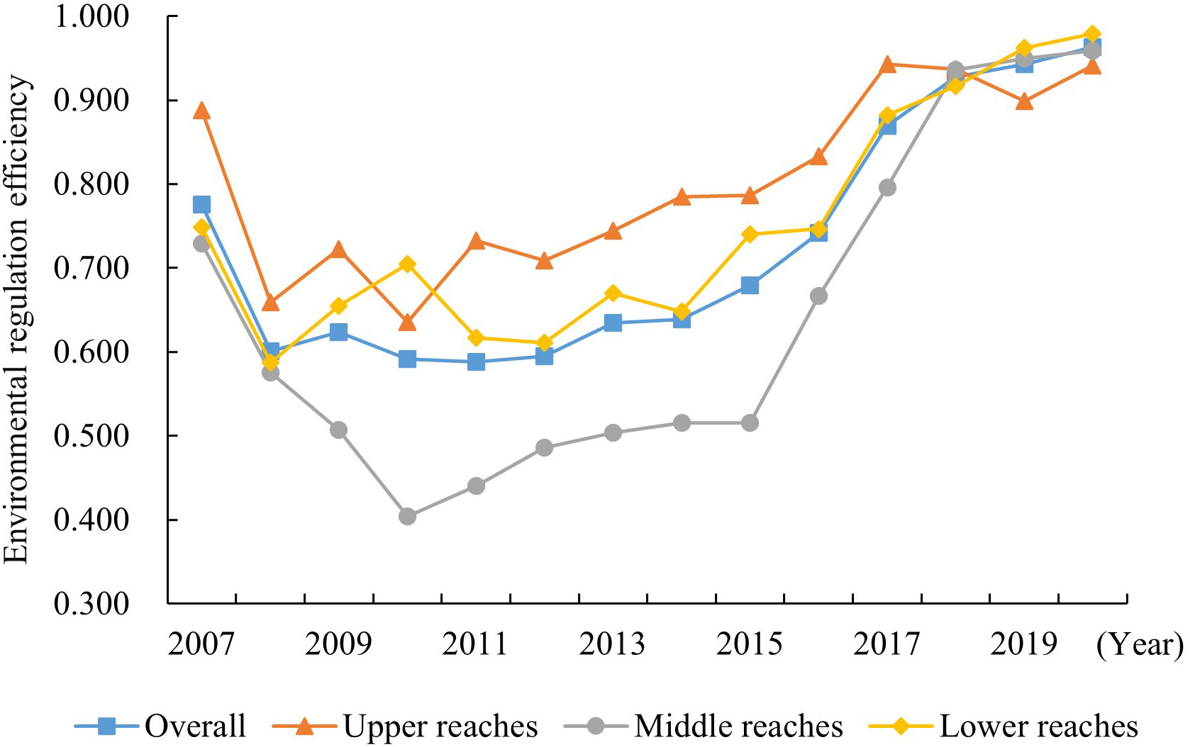

Slide 12
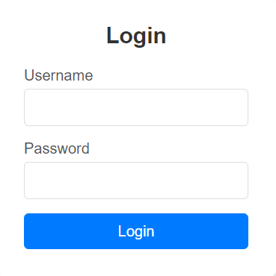

Login page

Slide 13
menu

Slide 14
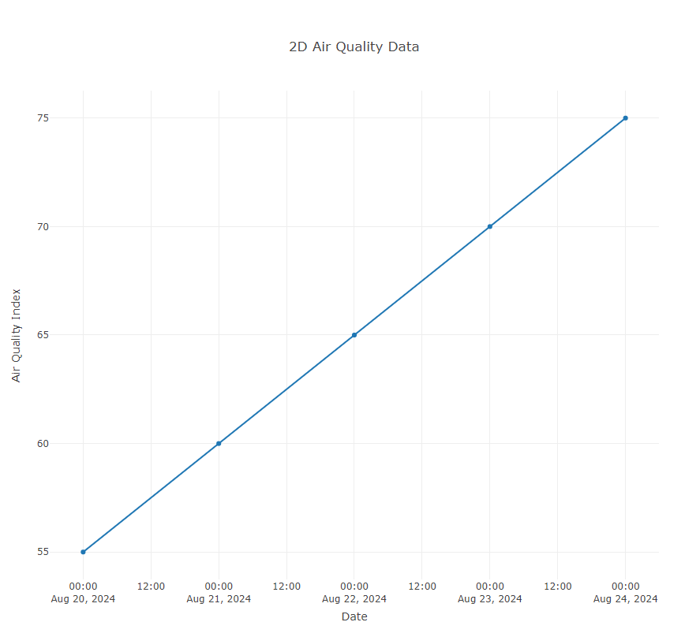

Slide 15
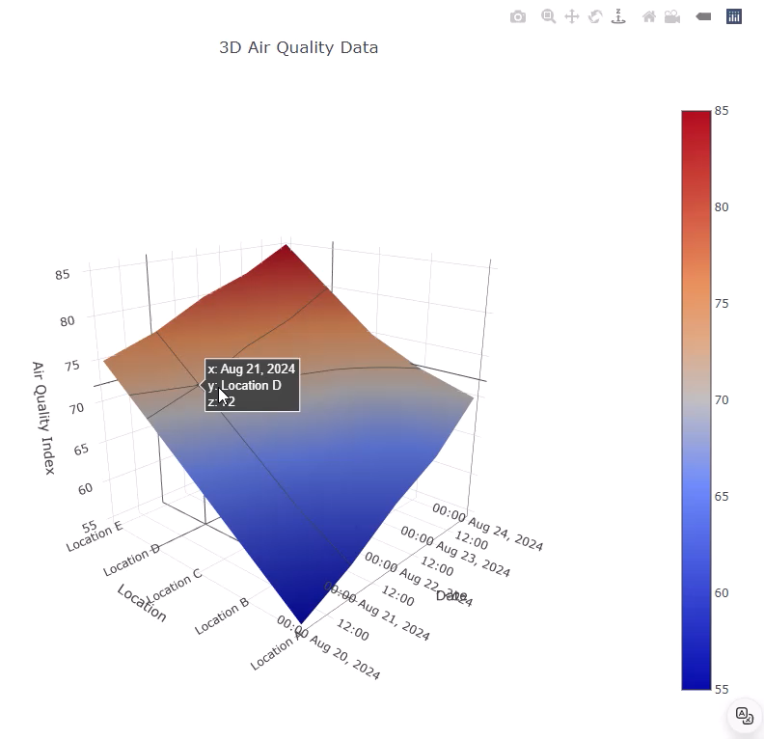
3D-Plot

Slide 16
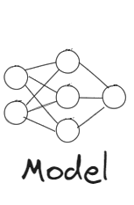
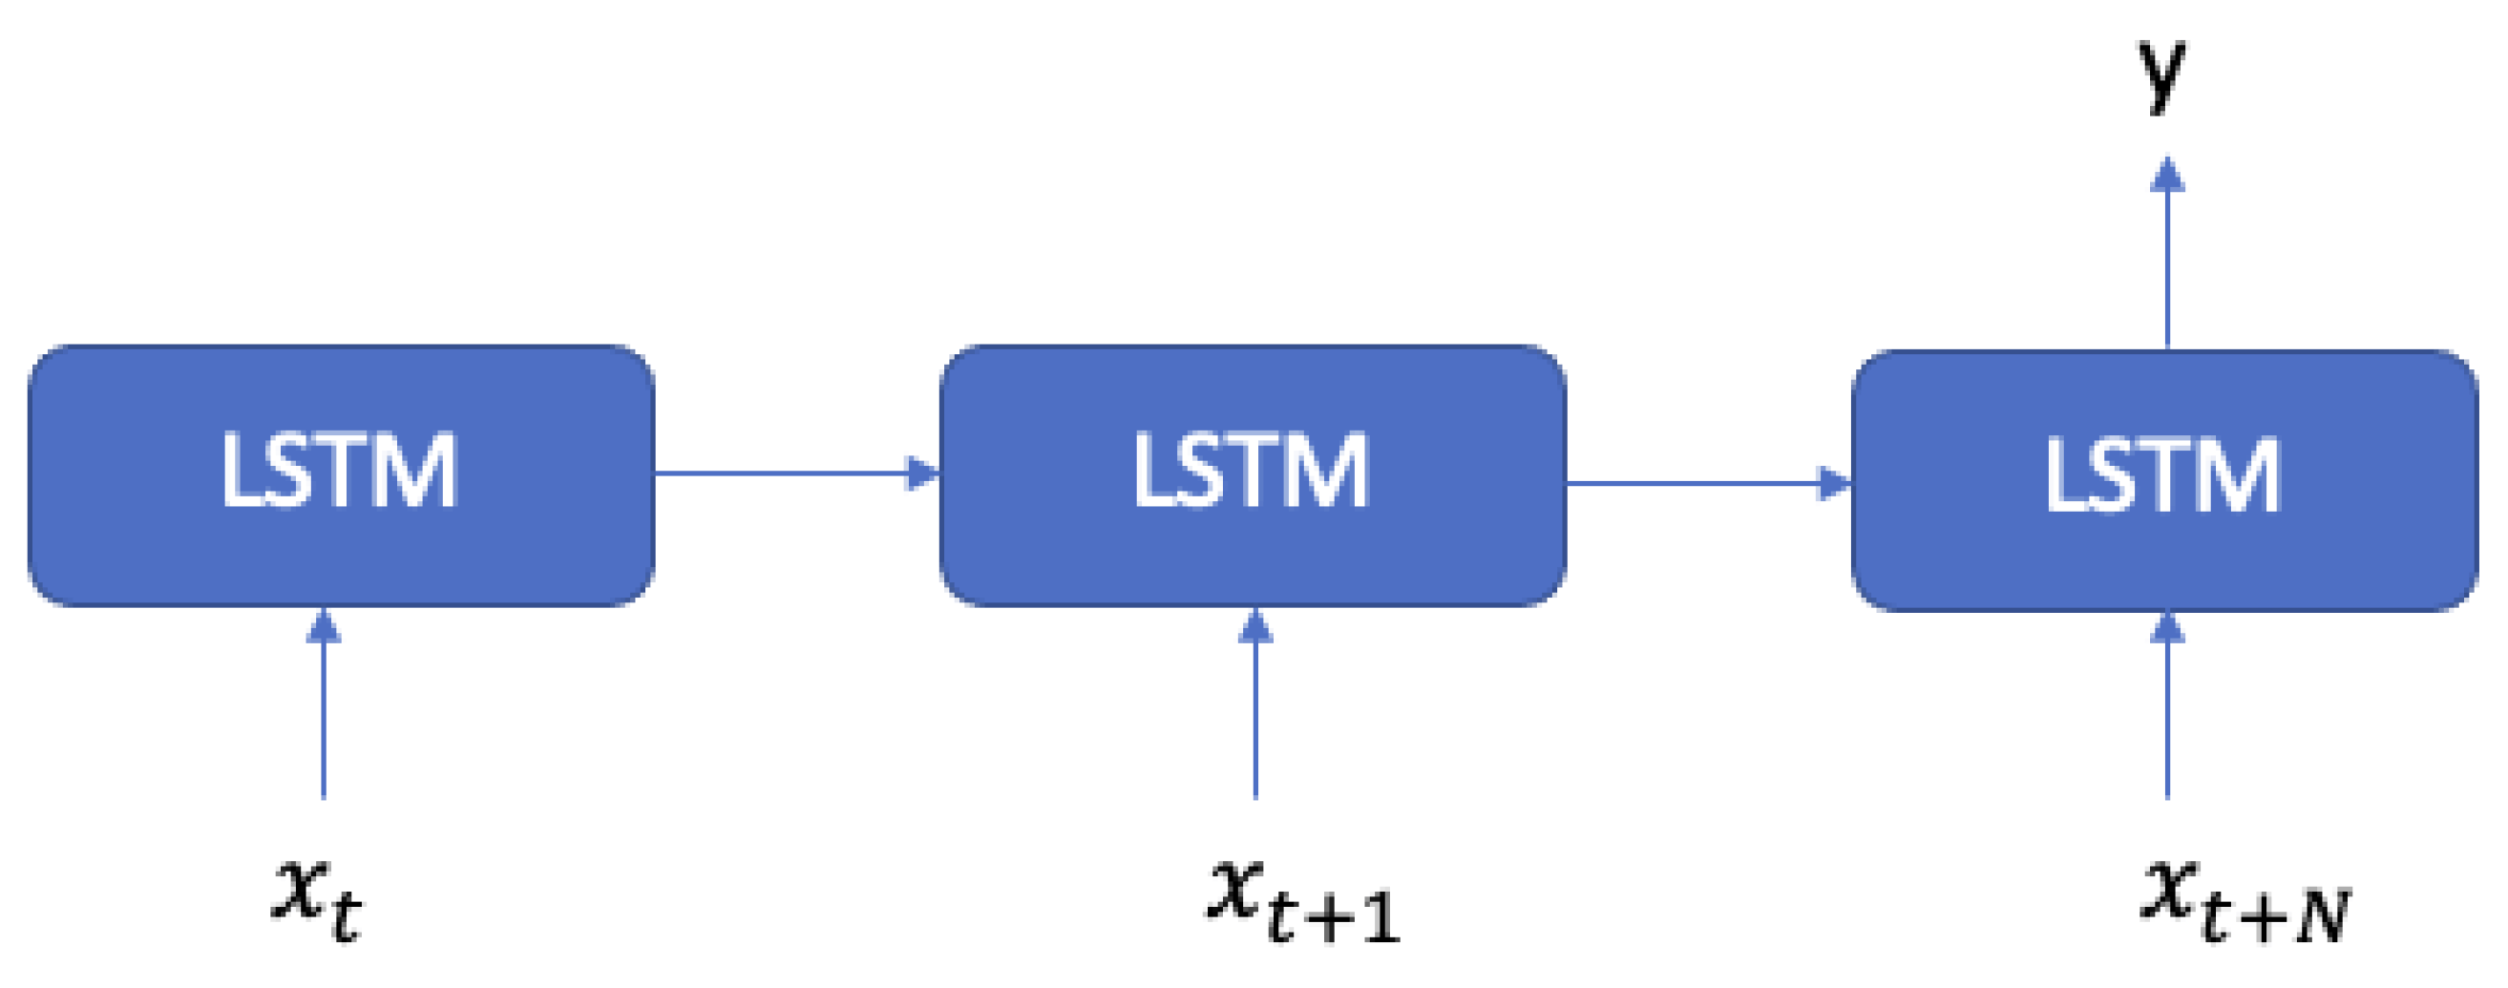
Using LSTM Algorithm modeling for Decision and analyze Data

Slide 17
Because our project is open-soures every one can use our project for own purpose .
A student can use our platform in own village, city ,town
mayor our department mayor can use for goal purpose.
The factory can use it to reduce its own pollutants.

Slide 18


Slide 19
